Slide 1
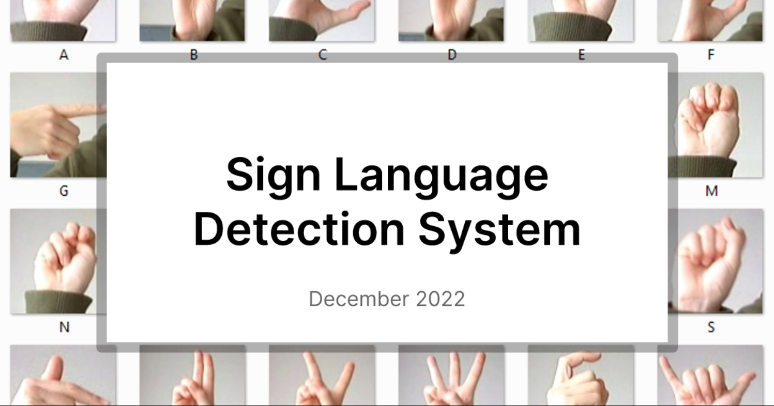

Slide 2
INTRODUCTION-
In today’s increasingly interconnected world , effective communication is fundamental to fostering inclusivity and understanding.
For the deaf and hard-of-hearing community ,sign language serves as a vital means of communication.
Our project , Sign Language Detection aims to address this communication barrier by leveraging advanced machine learning and computer vision techniques to recognize and interpret sign language gestures.
The core objective of this project is to develop a system capable of accurately detecting and translating sign language in real-time, providing a valuable tool for enhancing accessibility and fostering more inclusive interactions in various contexts.

Slide 3
ABSTRACT
The project Sign Language Detection addresses this challenges by developing an advanced system for real-time sign language recognition.
The goal is to accurately translate these gestures into text or speech , thereby facilitating seamless communication between sign language users and those unfamiliar with it.
Through this project we aim to bridge the communication gap promote inclusivity and support the broader integration of the deaf and hard-of-hearing community into everyday interactions.

Slide 4
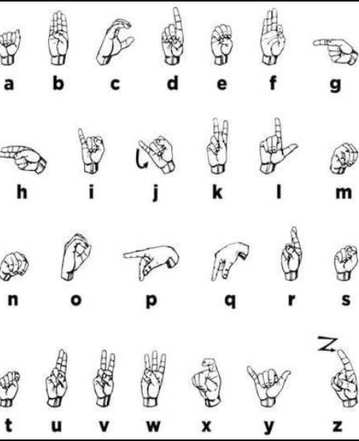
DIAGRAM-

Slide 5
OBJECTIVES-
Develop a real-time gesture recognition system-
Goal : create a robust system that can accurately detect and recognize sign language gestures from video input in real-time.
Outcome : the system should process video frames quickly enough to provide near-instant feedback to users.
Achieve high recognition accuracy-
Goal : utilize advanced machine learning algorithms and computer vision techniques to ensure a gesture recognition accuracy of at least 85% .
Outcome : minimize errors in gesture interpretation to provide reliable translations and enhance user trust.

Slide 6
SOFTWARE REQUIREMENTS-
Gesture Recognition-The system must detect and recognize a predefined set of sign language gestures from video input with high accuracy.utilize machine learning models for gestures recognition.
Real-Time Processing-The system must process video frames in real-time , providing immediate feedback to users . Ensures that the system can handle video input at a frame rate of at least 15-30 frames per second.
Gesture Translation- Translate recognized gestures into text or speech . implement text output for translations and integrate a text-to-speech engine for vocalizing translations.

Slide 7
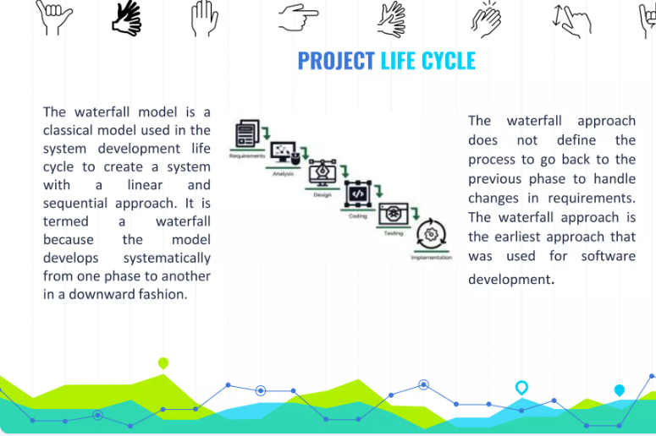

Slide 8
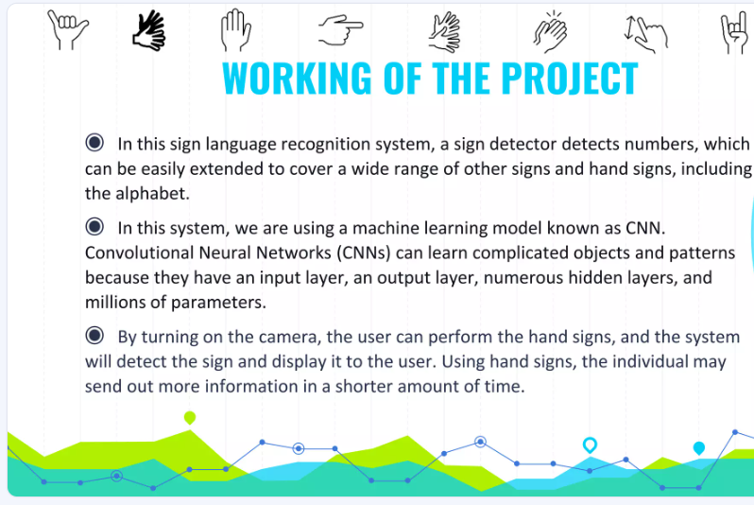

Slide 9
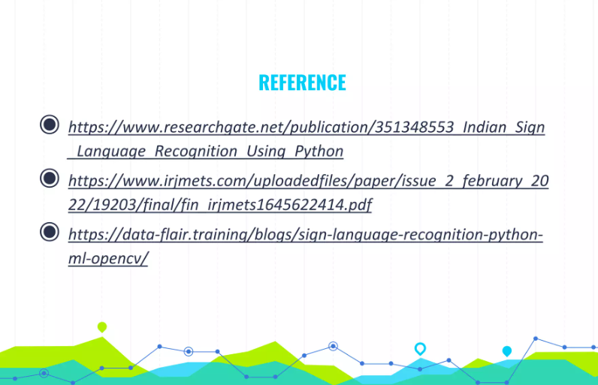

Slide 10
Conclusion-
We conclude that we made this system for helping deaf people from our system they will recognize a language detection using signs of there actions.
Develop a real-time gesture recognition system-
Goal : create a robust system that can accurately detect and recognize sign language gestures from video input in real-time.
Outcome : the system should process video frames quickly enough to provide near-instant feedback to users.
Achieve high recognition accuracy-
Goal : utilize advanced machine learning algorithms and computer vision techniques to ensure a gesture recognition accuracy of at least 85% .
Outcome : minimize errors in gesture interpretation to provide reliable translations and enhance user trust.

Slide 11
THANK U

